Slide 1

PlanteR-GB
Group 64
Winter is coming….
Zach Lerew, Travis Hodgin,
Max Schmidt, Austin Hodgin

Slide 2
Introduction

Slide 3
Timeline

Slide 4
User Interface & Web Service
Two different Interfaces
Command Line Interface Asks Questions About
Bed, Zones, Schedule, Profiles
Web interface will have different pages for each section
Bed, Zones, Schedule, Profile
Apache Web Service
Reliable
Process based

Slide 5

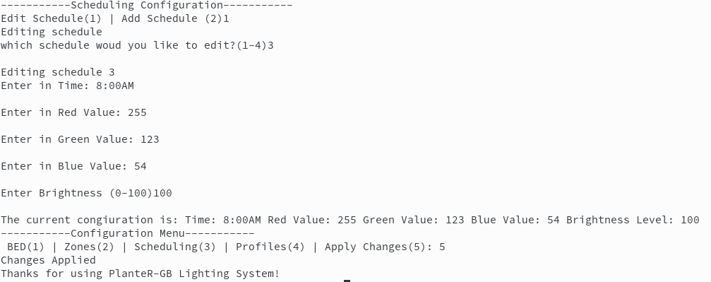
User Interface – Command Line

Slide 6
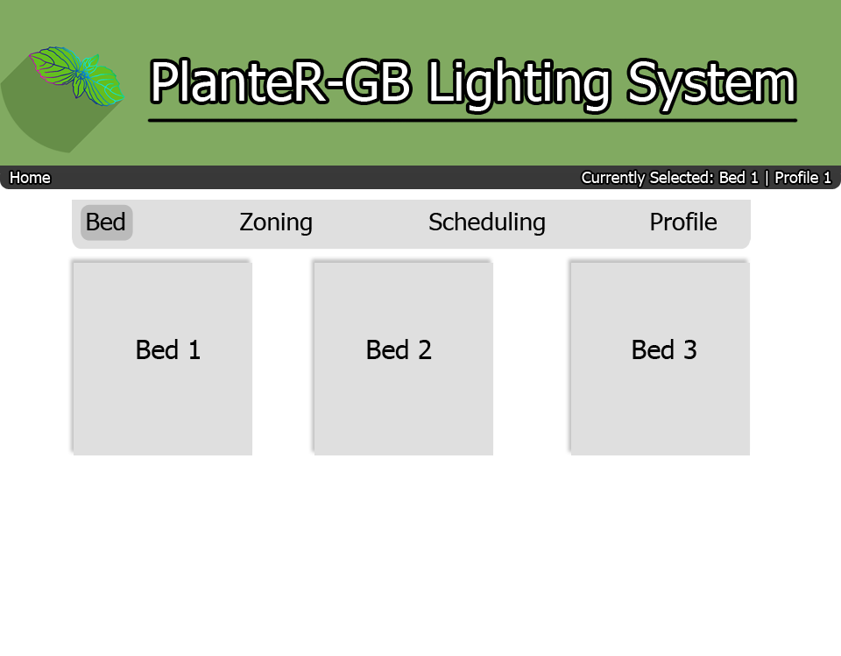
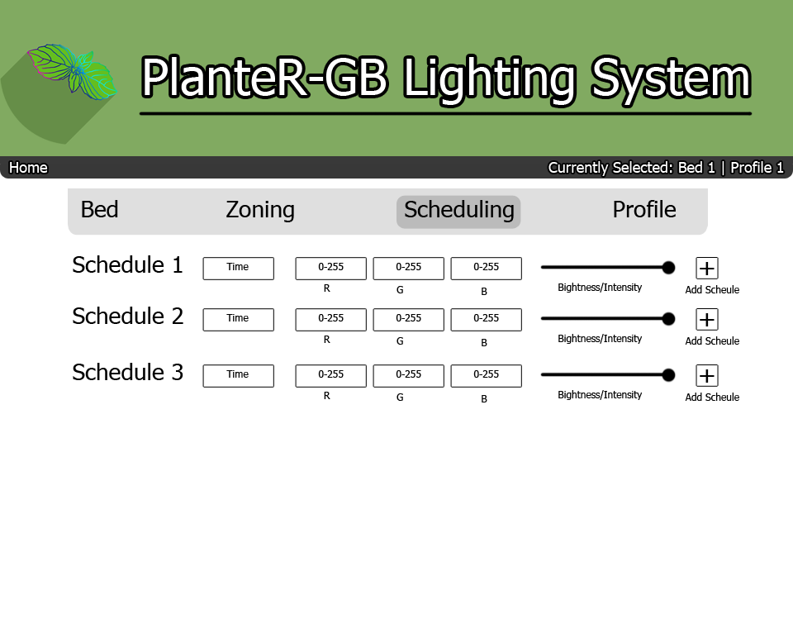
User Interface – Web Interface

Slide 7
System Architecture

Slide 8
Hardware

Slide 9
Conclusion

